Slide 1
TRANSITIONING OUR
CORPS IT INFRASTRUCTURE
TO THE CLOUD

Slide 2
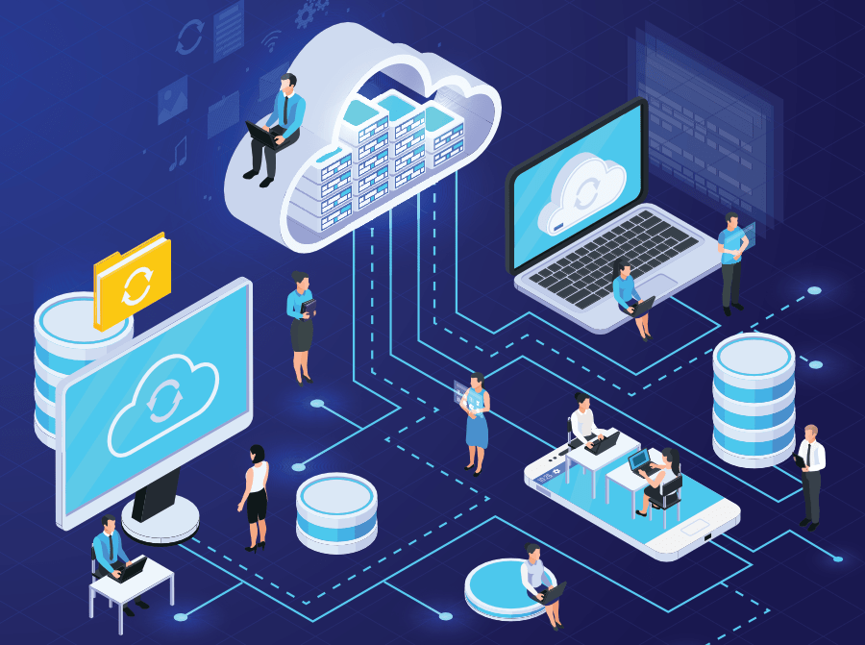
OUR OBJECTIVE:
Due to our primary facility being closed due to health restrictions and the increasing demand in our popular streaming services, our corps IT team has developed a plan to transition all of our corps IT infrastructure services and capabilities off premises, and on to the cloud.
This transition will allow us to increase our workload and operational capacity for the foreseeable future, all while maintaining in compliance with current and future health restrictions.

Slide 3
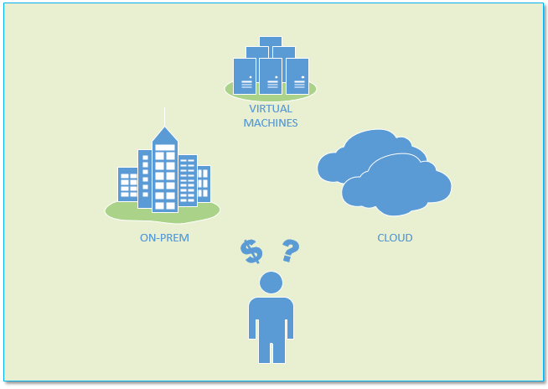
OUR SOLUTION:
Our solution to transition to the cloud will allow us to remain competitive in the content streaming market as well as continue to provide our customers with the level of service they expect.
Our solution to adopting a cloud Infrastructure-as-a-Service will not only bolster our IT productivity, but will decrease overall cost and maintenance, information security, but also increase availability.

Slide 4
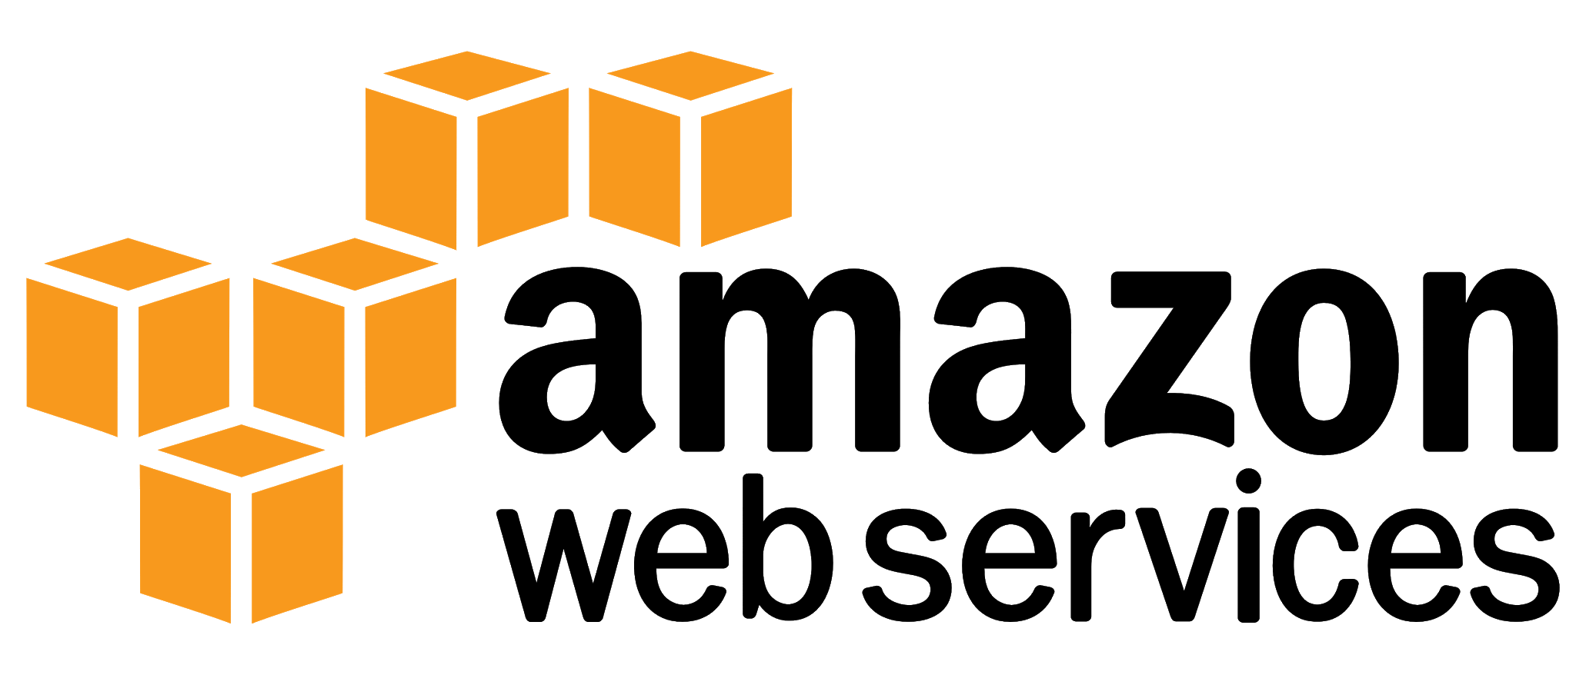

Slide 5

CLOUD COMPUTING BENEFITS/RISKS:
BENEFITS:
Scalable environments
On-Demand IT Infrastructure Capabilities
Lower capital costs
Lower IT Operating costs
Provider installation
IT Optimization
RISKS:
Multi-tenant security risks
Confidential data privacy
Compliance and Regulation Management
Availability risks
Severe Provider Dependency

Slide 6

OUR PLANNED MITIGATIONS FOR RISK:
RISKS:
Multi-tenant security risks
Our Solution: Purchase single-tenant servers
Confidential data privacy
Our Solution: IAM and Privacy configurations
Compliance and Regulation Management
Our Solution: Internal compliance assessment, frequent external compliance audits
Availability risks
Our Solution: Multiple AZ within each region
Severe Provider Dependency
Our Solution: In-depth vendor onboarding and risk evaluation

Slide 7
BUDGET OUTLOOK:

